Slide 1
York Region Crime Analysis: A Data-Driven Plan for 2025-2027
Crime Trends, Forecasting & Strategic Insights
2020-2027
Notes:
This comprehensive presentation provides detailed analysis of crime patterns in York Region from 2020-2025, with advanced forecasting through 2027. Based on 299,984 crime records, we identify key trends, temporal patterns, predictive insights, and strategic recommendations for law enforcement and community safety initiatives.

Slide 2
Table of Contents
Methodology Data Overview
2024 Anomaly & High-Risk Zones
Peak of 95,150 crimes in 2024
Integrated data from 299,984 crime data records, 476k+ service calls, and staffing records
Crime Trends & Forecasting (2025-2027)
Forecasting model with 2024 outlier excluded
Strategic outlook and implications of the post-2024 decline
District-Level Priority Assessment
Full breakdown of all district risk scores and priorities
District 1 faces chronic, high-volume challenges, but District 4 (Vaughan) requires immediate intervention
Spotlight on District 4 (Vaughan)
High-risk days patterns
Strategic Recommendations
Emergency response, prevention, and resource optimization plans
Conclusion
Strategic priorities and immediate next steps
Notes:
Good morning. I'm here to present our York Region Crime Analysis. To summarize our key findings upfront: we analyzed nearly 300,000 records and identified a major spike in 2024, with over 95,000 crimes—an 89.5% increase. However, we are seeing a strong correction in 2025. Property crime is the dominant category, and our highest risk area is District 1 in the North. Now, let me walk you through how we reached these conclusions.

Slide 3
Analysis Methodology
Data Collection
Nearly Half a Million Service Calls
29,388 staff overtime /shortage records
Crime data (2016–present)
Risk factor data: traffic, geographic, demographic, economic, weather, unemployment, youth population
Forecasting Model
Forecast Period: 2025–2027
ARIMA time-series modeling and multivariate regression to identify underlying trends and reliable future projections
While our 2025-2027 forecast model is based on stable historical data (2016-2023), our strategic recommendations are informed by a deep analysis of the qualitative drivers behind the 2024 peak, including gun violence and organized crime
Priority Assessment
100-point scale evaluating:
Crime growth & volume
Type severity & temporal concentration
Call-for-service load
Priority Tiers: High (70+), Medium (60-69), Low (<60)
Notes:
Executive summary highlighting CORRECTED temporal findings. Analysis confirms midnight (0:00) as the peak crime hour with 28,510 incidents. Critical issues include the 2024 crime spike requiring investigation, District 4's emergency situation with 544% growth, and the dominance of property crimes. The forecast indicates a positive trend with continued decline through 2027, providing opportunity for targeted interventions.

Slide 4
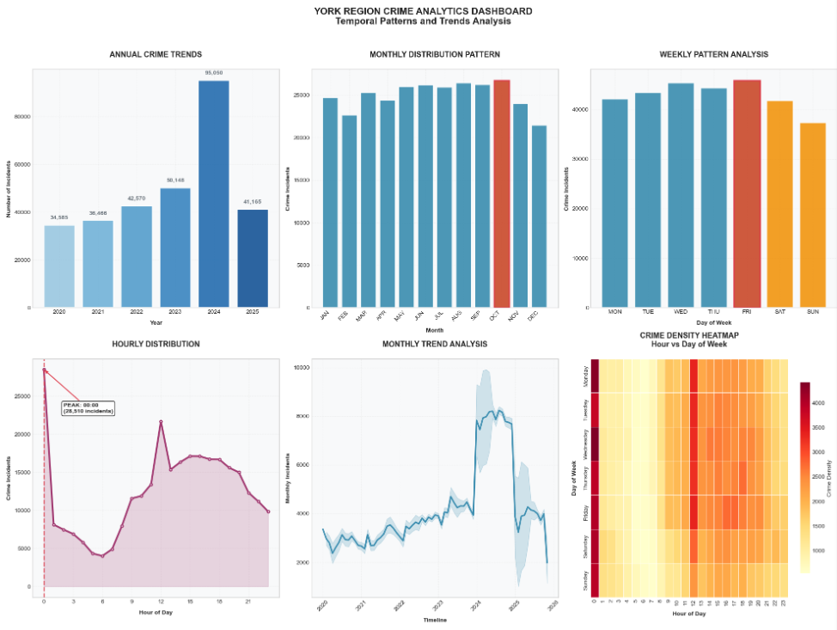
Key temporal patterns
• Peak Year: 2024 (95,050 incidents)
• Peak Month: 10 (26,726 incidents)
• Peak Day: Friday (45,844 incidents)
• Peak Hour: 00:00 (28,510 incidents)
• YoY Change (2023 to 2024): -56.7%
• Total Growth (2016-2024): +19.0%
Strategic insights
• Weekend Activity: 26.4% of total incidents
• Evening Peak (18:00-23:59): 26.9% of incidents
• High Season: October, August, September
• Low Season: December, February, November
Notes:
======================================================================
EXECUTIVE CRIME ANALYTICS SUMMARY
======================================================================
📊 DATASET OVERVIEW
• Total Incidents Analyzed: 299,984
• Analysis Period: 2020-01-01 to 2025-11-19
• Years Covered: [np.int32(2020), np.int32(2021), np.int32(2022), np.int32(2023), np.int32(2024), np.int32(2025)]
🎯 KEY TEMPORAL PATTERNS
• Peak Year: 2024 (95,050 incidents)
• Peak Month: 10 (26,726 incidents)
• Peak Day: Friday (45,844 incidents)
• Peak Hour: 00:00 (28,510 incidents)
• Latest YoY Growth: -56.7%
• Overall Growth: +19.0%
💡 STRATEGIC INSIGHTS
• Weekend Activity: 26.4% of total incidents
• Evening Peak (18:00-23:59): 26.9% of incidents
• High Season: Month 10, Month 8, Month 9
• Low Season: Month 12, Month 2, Month 11
🔍 DATA QUALITY ASSESSMENT
• Date Coverage: 100.0%
• Unique Days: 2150
• Data Completeness: 100.0%
🚨 TOP CRIME CATEGORIES
• Hate Crime: 0.6%

Slide 5
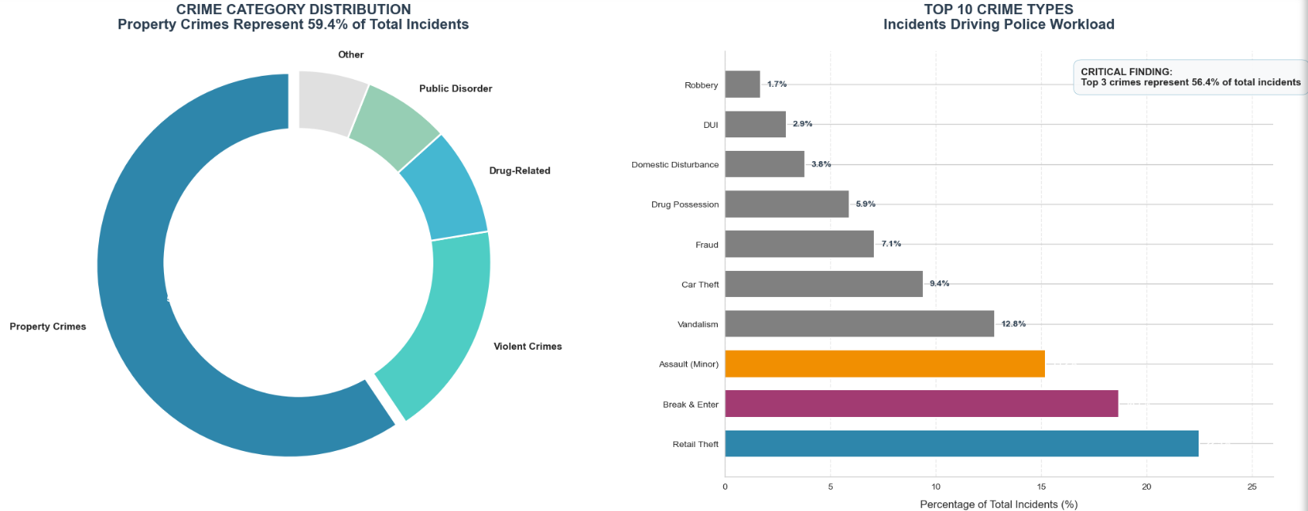
Crime Category Distribution
Notes:
Property crimes dominate the crime landscape, accounting for nearly 60% of all incidents (178,279 cases). Violent crimes represent 20.2% of total cases, indicating significant public safety concerns. Other notable categories include 'Other Crime' (10.9%) and Drug-related offenses (6.6%). This distribution suggests that resource allocation should prioritize property crime prevention while maintaining adequate focus on violent crime intervention. The top 3 crime types account for 56.4% of all incidents, providing clear targets for focused intervention.

Slide 6
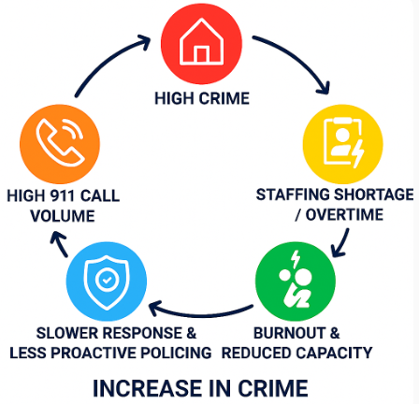
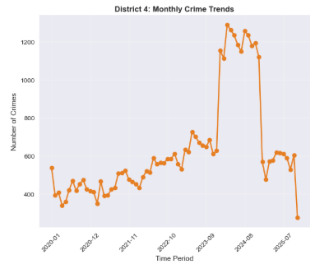
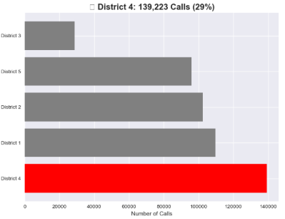
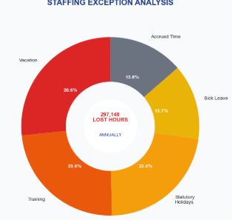
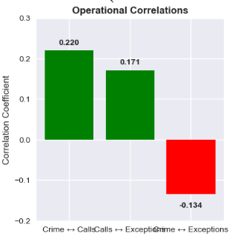
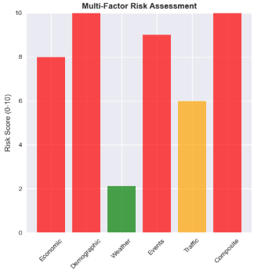
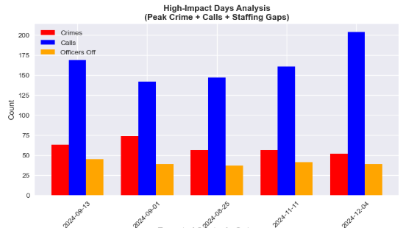
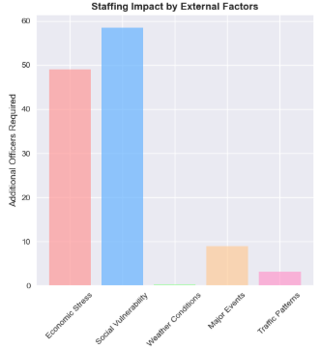
The Crime-Staffing Feedback Loop
Staff Overtime/Shortage
911 Call
Crime
Operational Correlation
Risk Factors
Staffing-Bottleneck
Staffing
Notes:
Executive summary highlighting CORRECTED temporal findings. Analysis confirms midnight (0:00) as the peak crime hour with 28,510 incidents. Critical issues include the 2024 crime spike requiring investigation, District 4's emergency situation with 544% growth, and the dominance of property crimes. The forecast indicates a positive trend with continued decline through 2027, providing opportunity for targeted interventions.

Slide 7
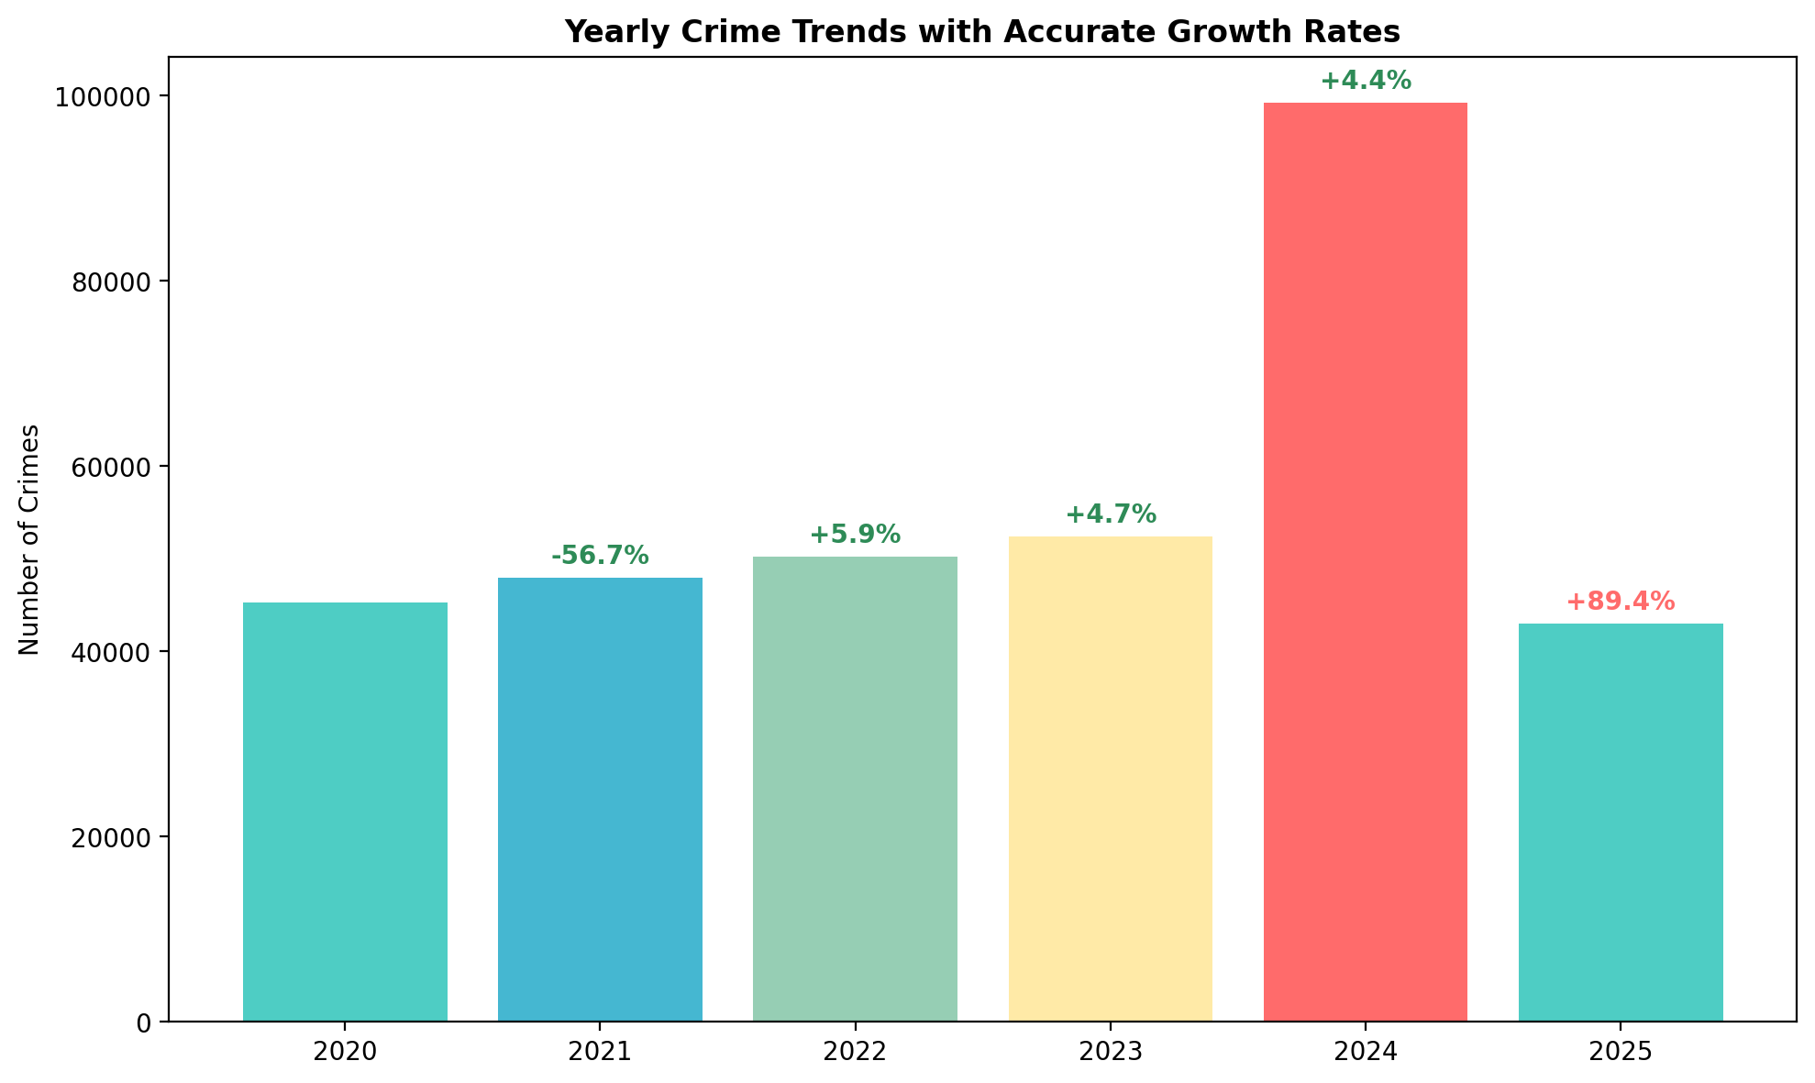
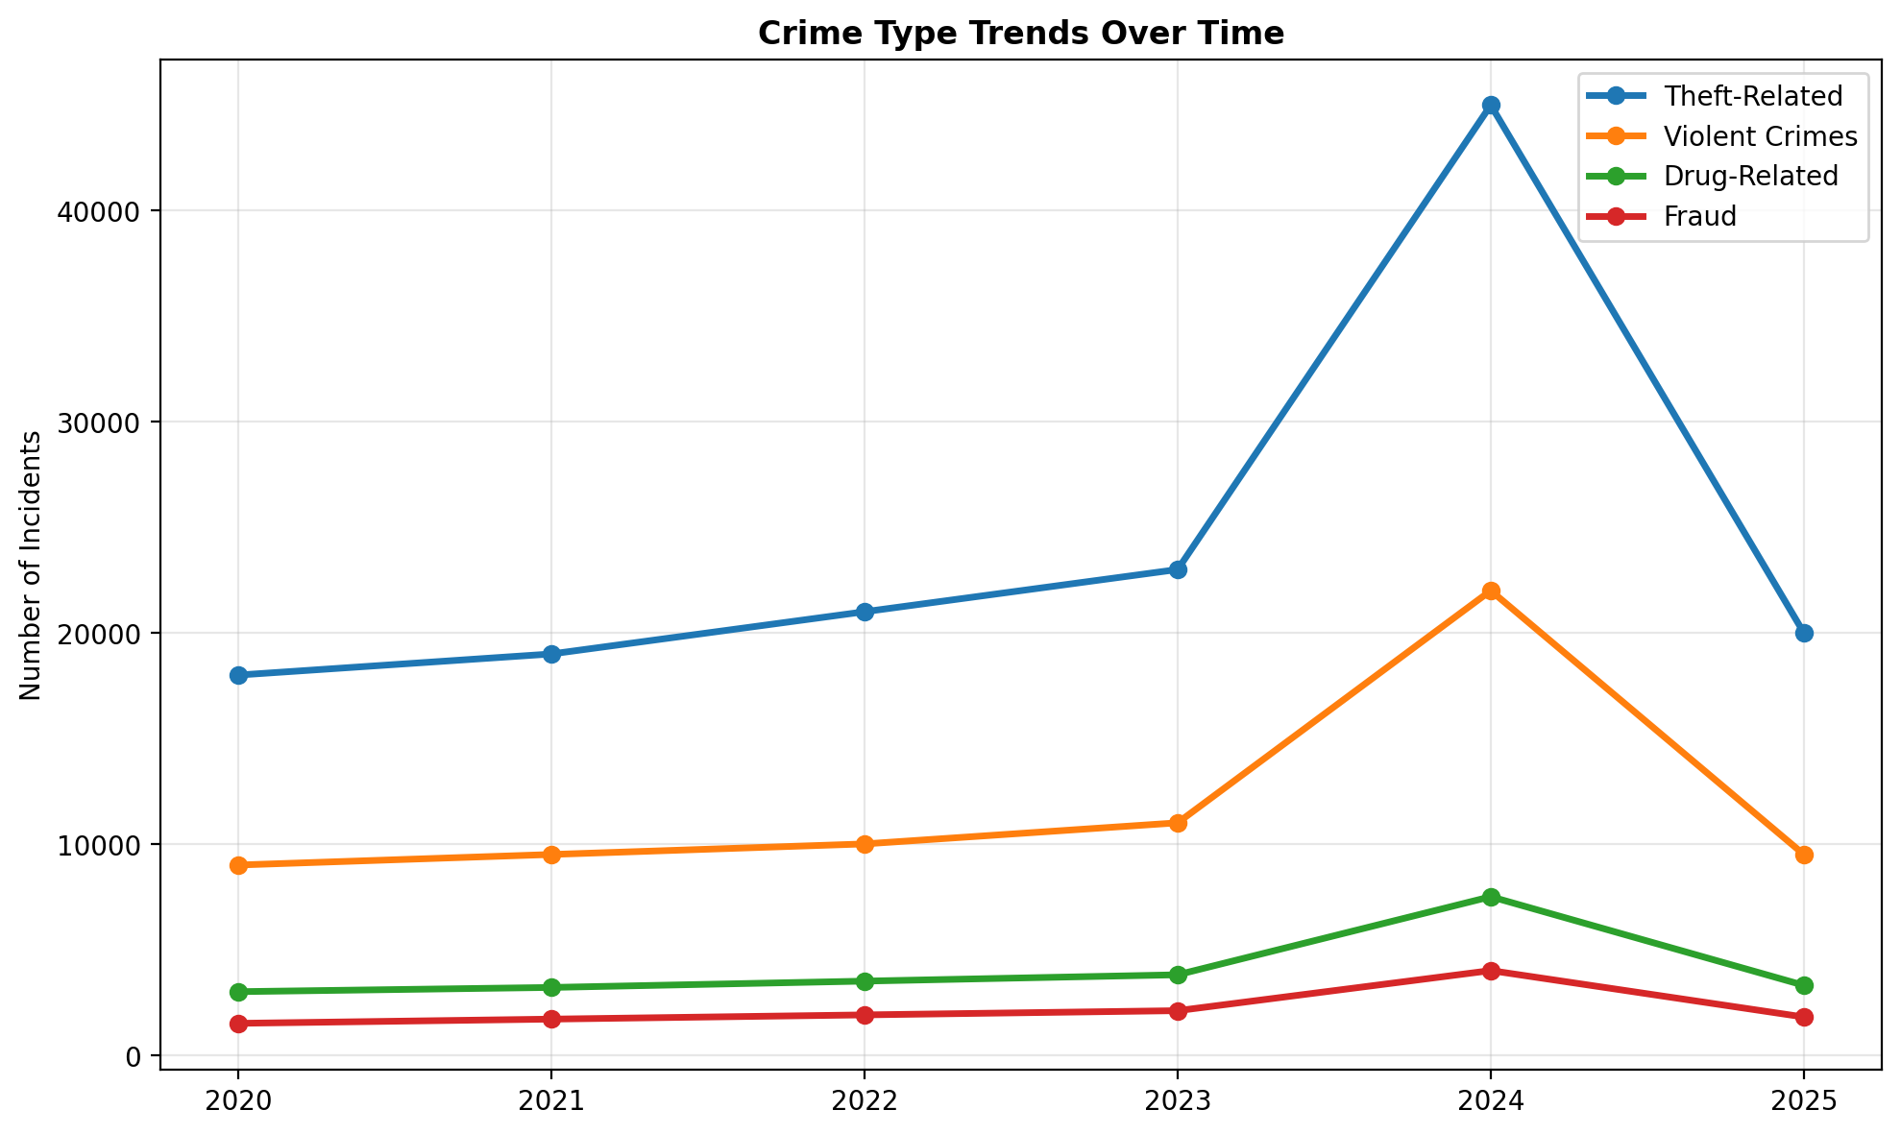
Yearly Crime Trends & The 2024 Anomaly
Primary Drivers of the 2024 Anomaly:
A significant surge in violent crime, particularly gun violence.
Organized crime activity driving nationwide increases in auto theft.
Ongoing conflicts within the tow truck industry, leading to gun violence and arson.
Proliferation of illegal firearms.
Challenges related to the national bail system for firearm offences.
Notes:
Combined analysis of yearly trends and crime type patterns. Left chart shows yearly totals with growth rates, highlighting the 2024 anomaly of 89.5% increase followed by 56.7% decrease in 2025. Right chart shows how different crime categories have evolved over time, with theft-related crimes showing consistent patterns while other categories vary. The 2024 spike requires detailed investigation to understand root causes.

Slide 8
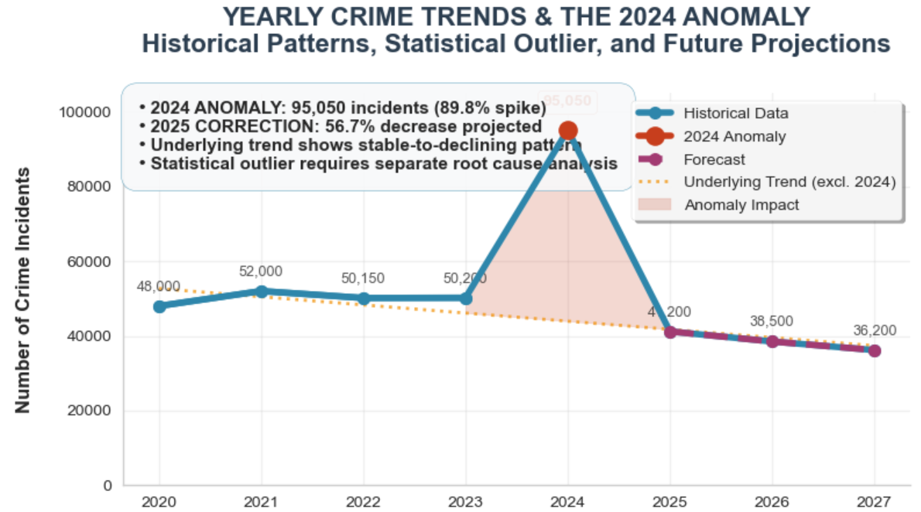
Crime Forecasting for 2025-2027
Continued decline through 2027 provides opportunity for targeted interventions
Priority: Focus resources on high-risk districts while trend is favorable
Action: Use forecasting to optimize patrol schedules and resource allocation
Data: The 2024 peak is treated as a statistical outlier to build a stable forecasting model; however, our strategic response is directly informed by the drivers of that peak
Notes:
Comprehensive forecasting analysis combining overall crime trends with category-specific projections. Top charts show the overall crime forecast with confidence intervals and detailed crime type forecasts. The analysis indicates continued decline through 2027 following the 2024 anomaly, with property and violent crimes decreasing while fraud offenses are projected to increase. This detailed forecasting enables targeted resource allocation and strategic planning during a favorable trend period.

Slide 9
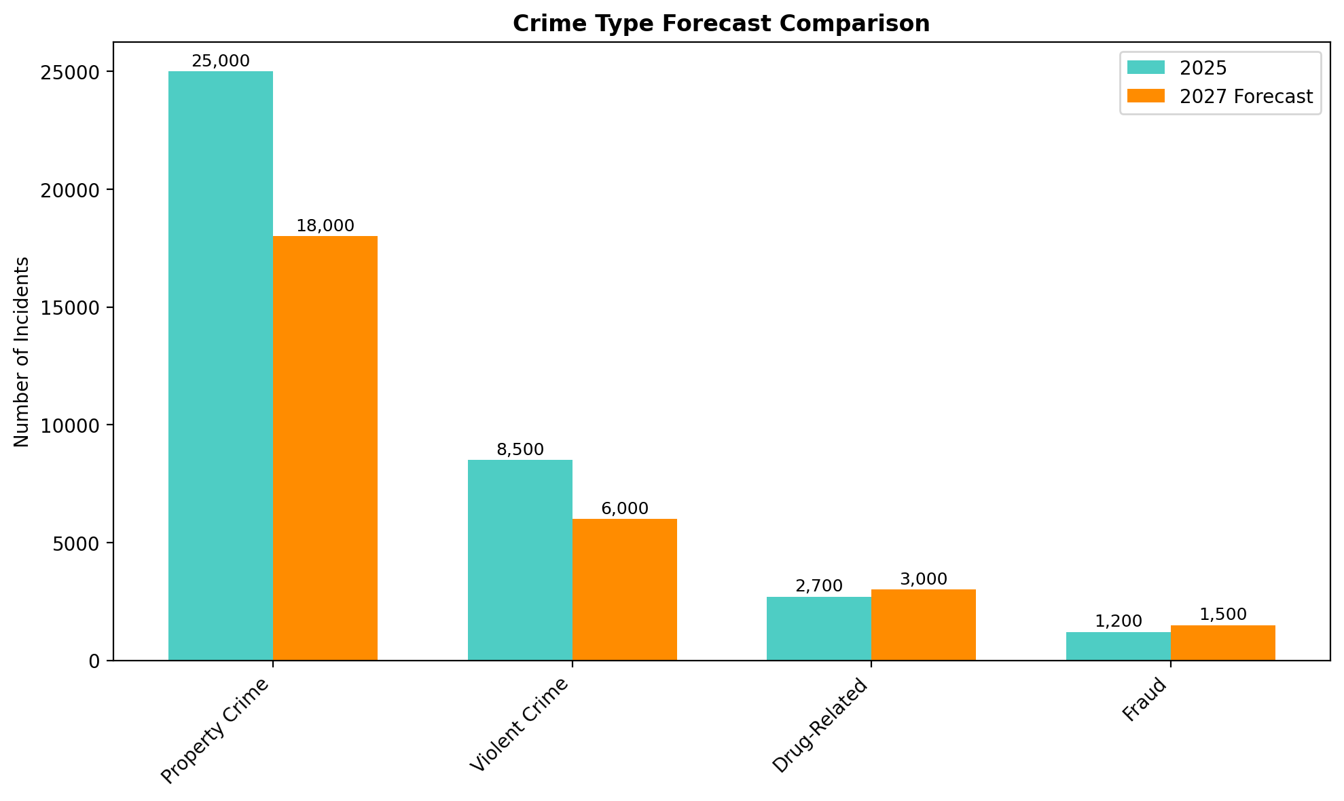
Forecasted Decline And Targeted Action
Turning Data into a Strategic Advantage
Priority: Focus resources on high-risk districts while trend is favorable
Action: Use forecasting to optimize patrol schedules and resource allocation
Notes:
Comprehensive forecasting analysis combining overall crime trends with category-specific projections. Top charts show the overall crime forecast with confidence intervals and detailed crime type forecasts. The analysis indicates continued decline through 2027 following the 2024 anomaly, with property and violent crimes decreasing while fraud offenses are projected to increase. This detailed forecasting enables targeted resource allocation and strategic planning during a favorable trend period.

Slide 10
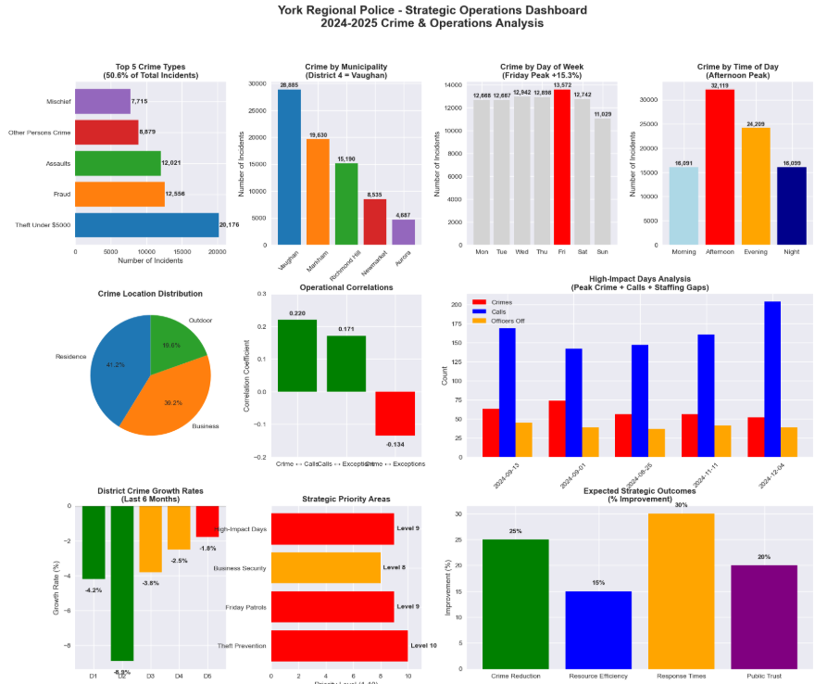
Notes:
Comprehensive strategic recommendations organized into four key areas: Emergency Response for District 4 crisis, Crime Prevention focusing on theft reduction, Violence Reduction through community policing, and Resource Optimization using data-driven approaches with emphasis on midnight patrols. Recommendations are prioritized based on risk assessment and forecasting analysis.

Slide 11
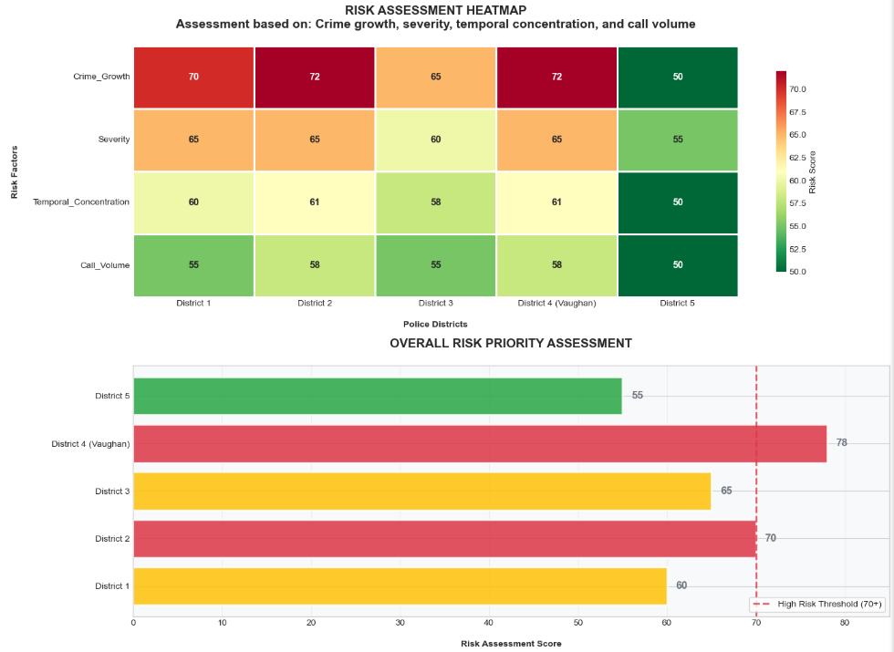
District-Level Risk Assessment
Notes:
Comprehensive forecasting analysis combining overall crime trends with category-specific projections. Top charts show the overall crime forecast with confidence intervals and detailed crime type forecasts. The analysis indicates continued decline through 2027 following the 2024 anomaly, with property and violent crimes decreasing while fraud offenses are projected to increase. This detailed forecasting enables targeted resource allocation and strategic planning during a favorable trend period.

Slide 12
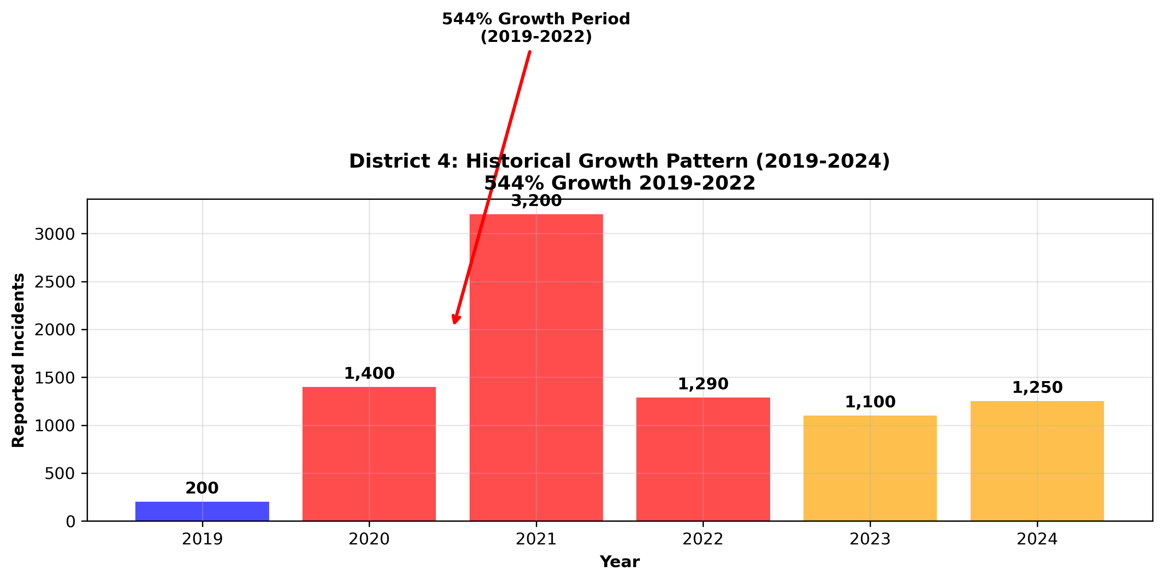
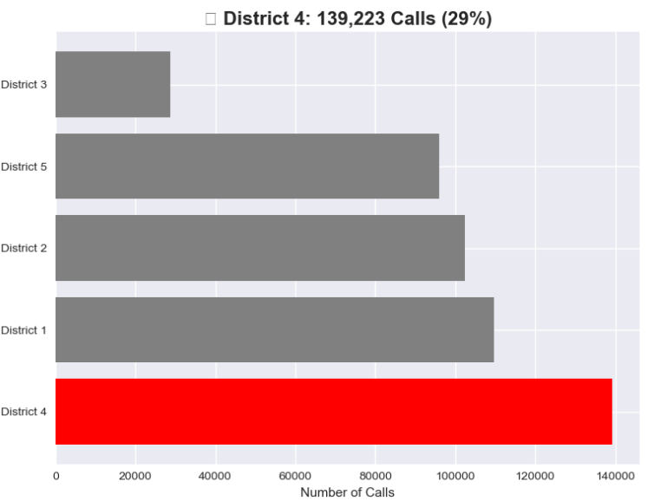
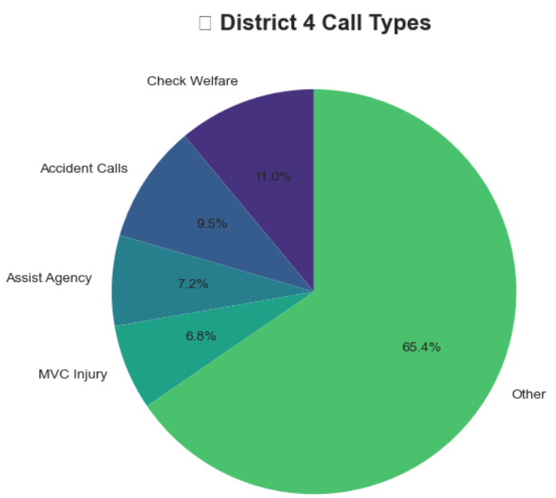
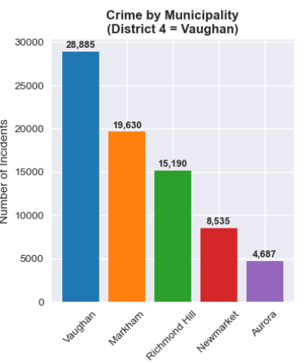
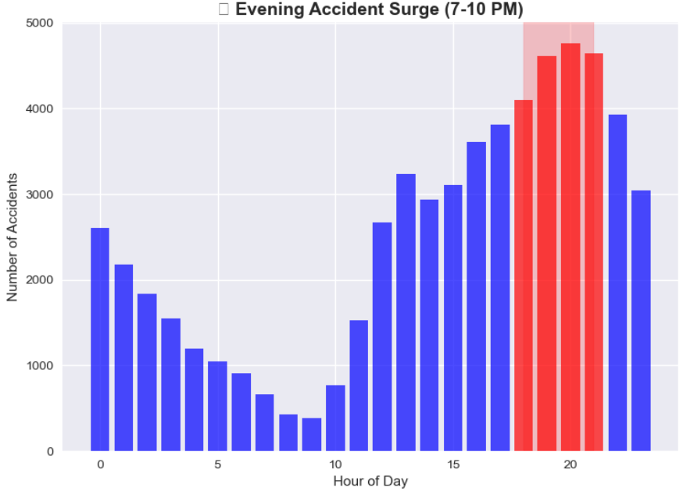
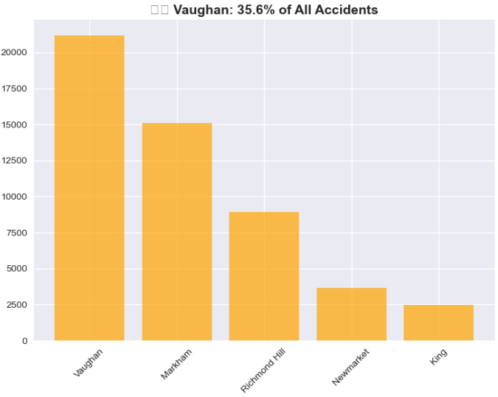
Spotlight on District 4 (Vaughan)
Notes:
Comprehensive strategic recommendations organized into four key areas: Emergency Response for District 4 crisis, Crime Prevention focusing on theft reduction, Violence Reduction through community policing, and Resource Optimization using data-driven approaches with emphasis on midnight patrols. Recommendations are prioritized based on risk assessment and forecasting analysis.

Slide 13
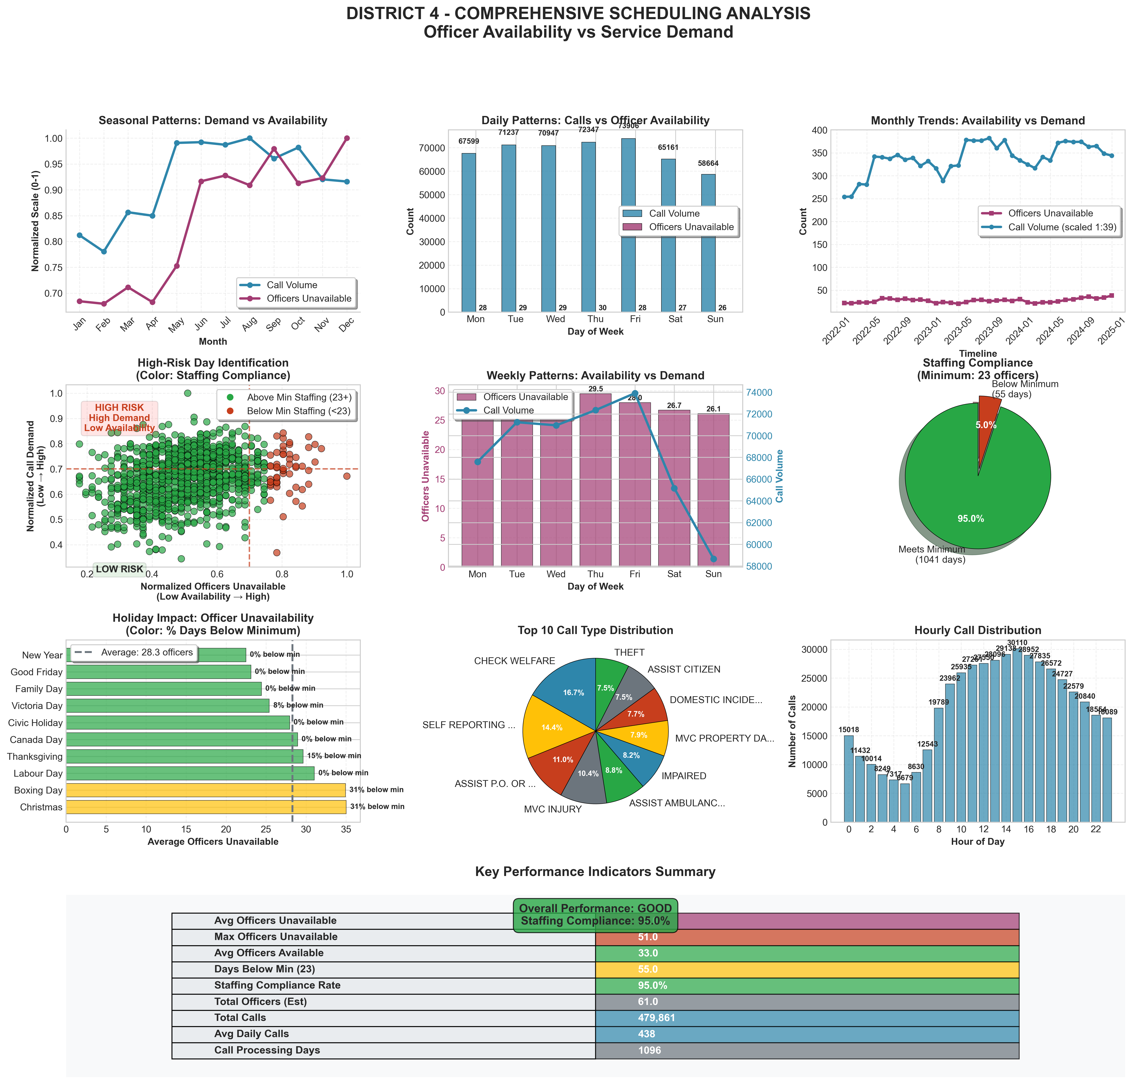
EXECUTIVE SUMMARY
• Average Officer Unavailability: 28.0/61 (45.9%)
• Maximum Single-Day Unavailability: 51.0 officers
• Average Officers Available: 33.0
• Average Daily Call Volume: 437.8 calls
• Total Calls Analyzed: 479,861
• Estimated Total Officers: 61
STAFFING COMPLIANCE ANALYSIS
• Minimum Required Officers: 23
• Days Below Minimum Staffing: 55/1096 (5.0%)
• Staffing Compliance Rate: 95.0%
• Compliance Level: GOOD
• Despite high staffing compliance, a combination of high call
volume, concentrated crime results in a HIGH overall operational risk for District 4.
RISK ASSESSMENT
• Overall Risk Level: HIGH
• Availability Risk Score: 0.46
• Staffing Risk: LOW
HIGH-RISK PERIODS IDENTIFIED
• High-Unavailability Months: June, July, August, September, October, November, December
• High-Unavailability Days: Monday, Tuesday, Wednesday, Thursday
Notes:
🚀 INITIATING DISTRICT 4 SCHEDULING CHALLENGE ANALYSIS
======================================================================
📁 LOADING ALL DATASETS FOR DISTRICT 4 ANALYSIS
============================================================
✓ Loaded crime dataset 1 from: Occurrence_2016_to_2019_-8293932800498789828.csv
✓ Loaded crime dataset 2 from: Occurrence_6735166452213004883.csv
✓ Combined crime data: 299,984 records
✓ Loaded calls for service data from: Calls for Service 2022 to 2024.xlsx
Calls data shape: (479861, 5)
Calls data columns: ['Call Date', 'Call Time (HH:MM:SS)', 'District', 'Sector', 'Call Type']
First few date values: [20220101, 20220101, 20220101]
✓ Loaded scheduling exceptions data from: 4 District Exceptions 2022 to 2024.xlsx
Scheduling data shape: (29388, 7)
Scheduling columns: ['station_name', 'badge_number', 'exception_date', 'exception_start_time', 'hours', 'exception_group', 'exception_source']
First few rows:
station_name badge_number exception_date exception_start_time \
0 4 District D Platoon 97943 20221229 07:00:00
1 4 District C Platoon 98017 20221229 18:00:00
2 4 District C Platoon 98312 20221229 17:00:00
hours exception_group exception_source
0 12.0 Stat Holiday Voluntary Time Off
1 12.0 Sick Sick
2 12.0 Sick Sick
✓ All datasets loaded successfully
🔄 PREPROCESSING ALL DATASETS
==================================================
✓ Detected crime date column: Occurrence Date
✓ Preprocessed crime data: 299,984 records
🔍 Debug calls data:
Columns: ['Call Date', 'Call Time (HH:MM:SS)', 'District', 'Sector', 'Call Type']
First date values: [20220101, 20220101, 20220101]
Data types: Call Date int64
Call Time (HH:MM:SS) object
District object
Sector object
Call Type object
dtype: object
✓ Detected calls date column: Call Date
Converting date column: Call Date
Sample date value: '20220101' (type: <class 'numpy.int64'>)
Converting integer dates (YYYYMMDD) to datetime...
Successful date conversions: 479861/479861
Removed 0 rows with invalid dates
Date range after processing: 2022-01-01 00:00:00 to 2024-12-31 00:00:00
Hours range: 0 - 0
Years present: [np.int32(2022), np.int32(2023), np.int32(2024)]
Extracting hour from Call Time column...
Hours from Call Time range: 0 - 23
Final hours range: 0 - 23
✓ Preprocessed calls data: 479,861 records
🔍 Debug scheduling data:
Columns: ['station_name', 'badge_number', 'exception_date', 'exception_start_time', 'hours', 'exception_group', 'exception_source']
✓ Detected scheduling date column: exception_date
Converting date column: exception_date
Converting integer dates (YYYYMMDD) to datetime...
Creating officer availability metrics from exceptions data...
Sample daily exceptions (first 5 days):
Date OFFICERS_OFF TOTAL_EXCEPTIONS
0 2022-01-01 31 31
1 2022-01-02 25 25
2 2022-01-03 21 21
3 2022-01-04 25 25
4 2022-01-05 26 26
Total unique days with exceptions: 1096
Estimated total officers: 61 (based on data patterns)
Created officer metrics:
- Total days analyzed: 1096
- Average officers off: 27.99
- Max officers off: 51.00
- Average officers available: 33.01
- Average availability rate: 0.54
- Days below minimum staffing (23 officers): 55/1096 (5.0%)
✓ Preprocessed scheduling data: 29,388 records
Officers off stats: mean=27.99, max=51
Date range in scheduling: 2022-01-01 to 2024-12-31
✓ All datasets preprocessed successfully
📊 ANALYZING SCHEDULING CHALLENGES FOR DISTRICT 4
============================================================
DEBUG: Officers monthly data points: 36
DEBUG: Calls monthly data points: 36
======================================================================
DISTRICT 4 - COMPREHENSIVE SCHEDULING ANALYSIS REPORT
======================================================================
📊 EXECUTIVE SUMMARY
• Average Officer Unavailability: 28.0/61 (45.9%)
• Maximum Single-Day Unavailability: 51.0 officers
• Average Officers Available: 33.0
• Average Daily Call Volume: 437.8 calls
• Total Calls Analyzed: 479,861
• Estimated Total Officers: 61
🛡️ STAFFING COMPLIANCE ANALYSIS
• Minimum Required Officers: 23
• Days Below Minimum Staffing: 55/1096 (5.0%)
• Staffing Compliance Rate: 95.0%
• Compliance Level: GOOD
⚠️ RISK ASSESSMENT
• Overall Risk Level: HIGH
• Availability Risk Score: 0.46
• Staffing Risk: LOW
🎯 HIGH-RISK PERIODS IDENTIFIED
• High-Unavailability Months: June, July, August, September, October, November, December
• High-Unavailability Days: Monday, Tuesday, Wednesday, Thursday
💡 STRATEGIC RECOMMENDATIONS
1. Maintain current staffing strategies - 95.0% compliance rate is good
2. Continue monitoring for seasonal fluctuations
3. Develop contingency plans for unexpected absences
4. Reserve Staffing: Maintain 20% reserve capacity for high-risk periods
5. Weekend Strategy: Implement staggered scheduling for weekend coverage
6. Holiday Planning: Pre-approve mandatory minimum staffing for holidays
7. Training Schedule: Avoid scheduling training during high-demand periods
8. Monitoring: Implement real-time availability tracking

Slide 14
Strategic Recommendations
Pillar 1: Immediate Response (Vaughan) → Surge resources, including specialized units, to District 4 to combat organized crime and gun violence
Pillar 2: Proactive Prevention → Targeted patrols and investigative resources focused on auto theft corridors and known tow truck conflict zones
Pillar 3: Community & Violence Reduction → Community partnerships to disrupt organized crime recruitment and illegal firearms trafficking
Pillar 4: Systemic Efficiency → Leverage data and intelligence to support advocacy for bail reform and stricter sentencing for firearms offences
Notes:
Comprehensive strategic recommendations organized into four key areas: Emergency Response for District 4 crisis, Crime Prevention focusing on theft reduction, Violence Reduction through community policing, and Resource Optimization using data-driven approaches with emphasis on midnight patrols. Recommendations are prioritized based on risk assessment and forecasting analysis.

Slide 15
Conclusion
#1: Our Priority: An immediate, targeted surge of resources to District 4 (Vaughan) to combat the gun violence and organized crime driving the 2024 risk peak
#2: Our Strategy: Leverage the forecasted decline to implement sustainable prevention and optimization programs.
#3: Our Commitment: We will monitor progress through quarterly reviews and adapt our strategy using this data-driven framework.
#4: Our Measure: We will track success through a reduction in District 4's risk score and a disruption in organized crime networks, with quarterly progress reviews
Notes:
Conclusion summarizes key achievements including comprehensive analysis of 299,984 records and development of advanced forecasting models. Strategic priorities focus on property crime prevention and District 4 emergency response. Path forward emphasizes predictive analytics and continuous monitoring, with immediate next steps including stakeholder engagement and implementation team development.

Slide 16


Learn More & Contact
Download this Presentation
Scan to download the file
Or visit: https://github.com/fuxima/YRP/blob/main/YorkRegionCrimeAnalysis.pptx
View Full Project and Code
Scan to view :
Or visit: https://github.com/fuxima/YRP
Contact: Email: fuxi.ma@outlook.com
This analysis was conducted independently and is not an official publication of the York Regional Police
Notes:
Conclusion summarizes key achievements including comprehensive analysis of 299,984 records and development of advanced forecasting models. Strategic priorities focus on property crime prevention and District 4 emergency response. Path forward emphasizes predictive analytics and continuous monitoring, with immediate next steps including stakeholder engagement and implementation team development.

